Slide 1
An Introduction to Campaigns
Notes:
Welcome to Brighton SU’s Online Campaign Training – An Introduction to Campaigns
Before starting this quick presentation, I’d like to highlight that if you would rather arrange a 121 training session where the slides will be more personalised to the campaign you have in mind, you can. Or, we do have our digital campaign toolkit on our SU website if you’d like some more detailed knowledge on campaigns and would like to run through it in your own time.

Slide 2
What is a Campaign?
Notes:
Customise with campaigns relevant to the students who are attending the session
(bottom left = Britain get talking)
So what is a campaign? Here are some examples of past successful campaigns –
National Carers week, the me too campaign, Britain get talking and change4life.
You’ve hopefully heard of most of these campaigns before, but if you weren’t aware – the Britain get talking campaign, for example, was launched by ITV in 2019 to encourage us all to focus on our mental wellbeing. It got millions of people talking and reaching out to each other, especially in lockdown. Depression doubled during lockdown, as well as anxiety and loneliness becoming more prevalent. So this campaign was successful in spreading awareness and pushing people to communicate.

Slide 3
Campaign in 5-easy-steps
1
Set clear goals and aims
2
Become an expert
3
Resource pool
4
Target and lobby
5
The logistics
Notes:
So I’m going to run through campaigning in 5 easy steps… (LIST)

Slide 4
Step 1: Set SMART Goals and Aims
Identify the problem: Hedgehog’s becoming extinct
Setting a goal: To spread awareness of hedgehog extinction
S – To increase Hedgehog extinction awareness at the University of Brighton
M – To increase Hedgehog extinction awareness by 20% at the University of Brighton
A – To collect student and staff data via quarterly surveys and after meetings/events to ensure that awareness is being raised at the University of Brighton
R – To host weekly group meetings where aims and events are discussed and planned at the University of Brighton
T - To increase Hedgehog extinction awareness by 20% from the start of the 2021/2022 academic year to the end of it at the University of Brighton
Specific
Measurable
Achievable
Relevant
Time
Notes:
Before you start your campaign you need to pinpoint exactly what you would like to change looking at what is the issue and why it’s a problem. Once you have identified the problem you can turn that around into solutions or ‘goals’ to form the basis of want you want from your campaign (jigsaw activity)
Your campaign goal is the overarching thing you want to change. It helps set the purpose of your campaign and should describe what you want to achieve.
Your campaign objectives are the smaller steps you will take to achieve this.
To help set your campaign objectives use the SMART model below:
You can advocate for anything that is of interest to you!
SMART goals are:
Specific: Well defined, clear, and unambiguous
Measurable: With specific criteria that measure your progress toward the accomplishment of the goal
Achievable: Attainable and not impossible to achieve
Relevant: Within reach, realistic, and relevant to your campaign purpose
Time-bound: With a clearly defined timeline, including a starting date and a target date. The purpose is to create urgency.
One example of Students and Staff coming together at the University of Brighton is the Hedgehog Friendly Campus campaign.
Here are some example SMART goals that the campaigners may have come up with…
S – To increase Hedgehog extinction awareness at the University of Brighton
M – To increase Hedgehog extinction awareness by 20% at the University of Brighton
A – To collect student and staff data via quarterly surveys and after meetings/events to ensure that awareness is being raised at the University of Brighton
R – To host weekly group meetings where aims and events are discussed and planned at the University of Brighton
T - To increase Hedgehog extinction awareness by 20% from the start of the 2021/2022 academic year to the end of it at the University of Brighton

Slide 5
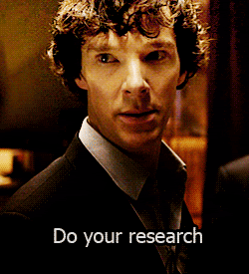
Step 2: Become an Expert
Knowledge is power
What do you need to know?
Where can you find it?
Lived Experience
Notes:
Become an expert in the area of your campaign. If you are running a campaign on sustainability, explore this area of campaigning as thoroughly as possible. Facts and figures are always a great way to persuade audiences to believe in your campaign.
Think about what angle you’re coming from and what information you need to find out. In the next slide I’ll talk about ways in which you can gather this information.
Also, It’s always good to include your lived experience to make your campaign approach more personable and relatable to others – again a great way of persuading an audience and getting them to believe in your passion.

Slide 6
CATEGORY | SOURCE
Local | Brighton SU Brighton University Ask your MPs Brighton & Hove County Council
National | National Union of Students (NUS) Student Unions Universities Office for National Statistics (OFS) Parliamentary briefings/Hansard Trade Unions British Medical Organisations
Global | Trade Organisations United Nations Charities (e.g. Oxfam, Water Aid) Other Governments
Notes:
Here is a table showing the ways you can gather information and which potential stakeholders you could contact.
I’ll leave it up for a second so you can take a look for yourself…

Slide 7
Step 3: Resource Pool
Time: exams and deadlines
Money
Online space
Access to printing
Time: holidays
Training
Canva wiz
Notes:
For a campaign to be successful you need to establish what resources and support you need and what you currently have.
When planning a campaign, start by sitting down and considering all of the resources available to you; there are the physical resources such as budget and materials (tables for a stall, paper for marketing materials - anything you can use to add to your campaign), however, people also count as a resource.
Consider who is willing to be involved in this and organise activities.
Finally time- be realistic about the amount of time you can put into your campaign. Plan ahead and be aware of how busy terms can get- with everything being online at the moment you can take full advantage and start prepping materials and scheduling posts in advance.
Then consider what you might need- research other campaigns, both locally and nationally, for inspiration and guidance on what resources you might need, for example do you need an online space for your campaign (fb page/ website (( you can use free/ paid host pages, or the su can collaborate campaign and you use our website as a space)
Another key resource often forgotten is peoples support. Campaigns often recruit advocates and allies to help promote their cause. In a COVID situation this can be done over zoom or Microsoft teams (all Brighton students have access to them).
You could run an open meeting or information session calling for people who are interested to attend, and run a mini workshop on why the issue is important and how they can get involved.

Slide 8
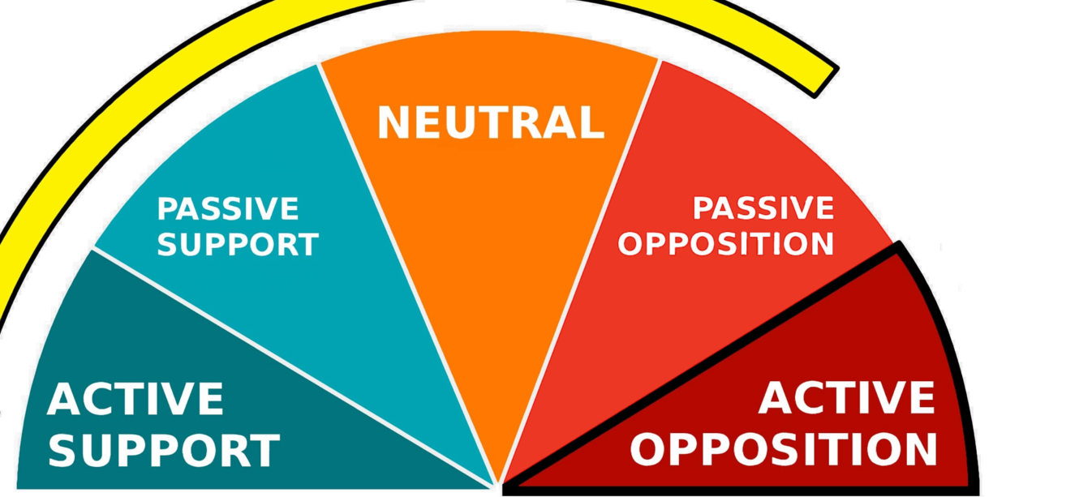
Spectrum of Allies
Notes:
A way to help you gain more supporters is to use the spectrum of allies.
As mentioned in the last slide, Campaigns often recruit advocates or allies to help promote their cause.
This tool can help you think about the people you have access to that can help support your campaign as well as the people that still need convincing.
Move from wedge to wedge placing different individuals or groups in each wedge. You can then start to design actions or tactics to move your people from one wedge to the left.
*For this tool to work effectively you need to be specific, ‘the public’ is too broad and your campaign actions might not be as effective.
Active support: People who agree with you and are organising alongside you
Passive support: People who agree but aren’t doing anything about it (yet!)
Neutrals: People who aren’t sure, or are unengaged (they might just not know about you yet)
Passive Opposition: People who disagree, but aren’t trying to stop you
Active opposition: People who have done something to prevent you from reaching your goal

Slide 9
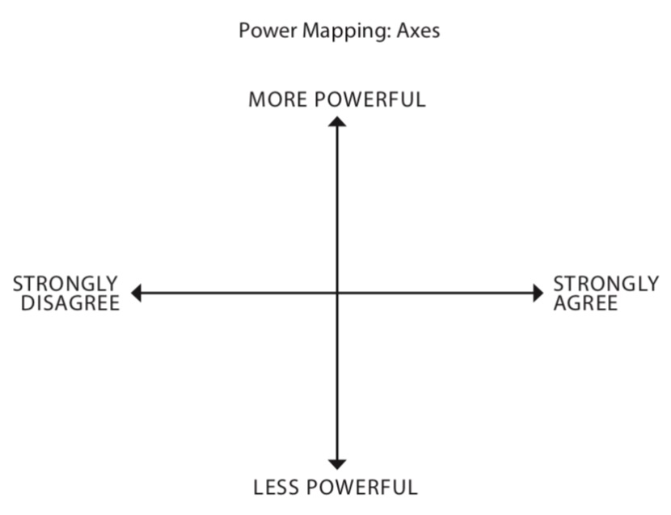
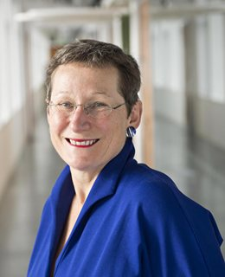
Step 4: Target and Lobby
Notes:
The challenge of campaigning can be ensuring momentum isn’t lost so the person/ organisation you are campaigning against continue to feel pressure.
Explain power mapping- use key people in the university/ and or student officers
Point out the axes.
Then, say you are the student on the right, who strongly agrees – alongside your fellow students who support your cause. As you are leading your campaign and are now aware of your allies and opposing stakeholders, you will use your strategy to target and lobby against the more powerful stakeholders.
This strategy will involve getting as many people on your side as possible, likely to be student supporters or allies such as local charities, who can then adopt your methods of targeting and lobbying to increase their involvement and power, ensuring the momentum of your campaign. This will put a lot of pressure on the more powerful opposition and challenge the system they have in place.

Slide 10
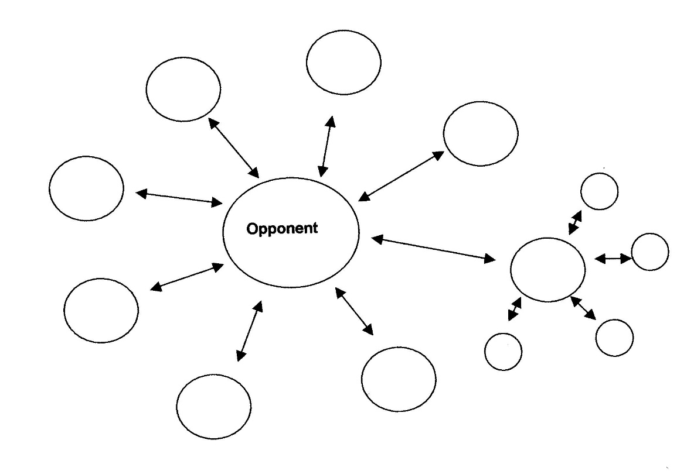
Step 4: Target and Lobby
Notes:
Following on from this, you can feel free to use this graph to plan your approach with your support, and use the strategies to plot your various moves against the opposition using your ally stakeholders.

Slide 11
Step 4: Target and Lobby
ANGER– righteous anger – people need to feel that someone/ something is taking advantage of them. People need to feel injustice.
HOPE – people need to feel that things can get better.
ACTION – people need to see that time to move is NOW, later or tomorrow will be too late
YOU can make a difference!
Notes:
Creating an argument (Anger, Hope, Action model)
When talking to people about your campaign, a key way to get them engaged is through using the Anger, Hope, Action model of engagement. This model takes people through the emotional stages of being angry about an issue, hopeful there is a solution, and then invites them to get involved by giving them an action.
Anger
Make someone angry about the issue. Explain to them what you are campaigning about and why it is unfair or unjust.
Hope
Don’t leave someone angry about the issue. Give them hope that it can change. Identify why there is hope at this particular moment. Talk to them about it and why it is so important to support your campaign at the moment and what the chance of success is.
Action/Urgency
This is the most important part of the conversation and often the part that most people forget. Always have a clear action you’d like people to take and ask them to commit to it.
The action can be anything that meaningfully takes your campaign forward, from signing up to being part of the campaign team, attending the next meeting or joining in a protest.
TOP TIP!
You can also use an Apathy Staircase to complement or replace this tool, it is a similar model for and creating your argument and engaging your audience.

Slide 12
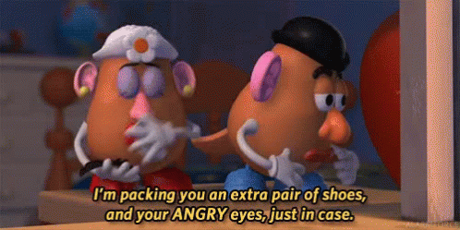
Lost at Sea
A shaving mirror
Mosquito netting
20 litre can of water
Case of army rations
Map of Pacific Ocean
Floating seat cushion
7.5 litre can of petrol
Small radio
Plastic sheeting
Shark repellent
2 litres of rum
5m rope
2 boxes of Maltesers
Fishing kit
Hairbrush
Notes:
THIS SLIDE IS FOR IN-PERSON / TEAMS MEETINGS WITH STUDENTS – BUT CAN ALSO BE USED BY STUDENTS FOR STUDENTS IN MINI WORKSHOP’S ETC.
Split students into teams.
Scenario- you are lost at sea and can only save 5 items- you have 3 minutes to decide what to take
1 minute left- the boat you are on is sinking fast you can only save 1 item
Bring students back together and ask for feedback, did anyone have strong opinions, did the groups disagree, how did you reach a conclusion
Point of exercise= everyone has the ability to persuade
Fun fact- US coastguard suggests saving the shaving mirror (can be used to signal, start a fire, cut things)

Slide 13
Step 5: The Logistics
Making an impact
Stall/ festival
Debate/ panellist
Protest/ online version
Round table event
Letter writing/ tweet/ tag
Boycott
Zoom workshops
Media and messaging
Creating a brand (Canva!)
Fb events
Instagram accounts
Don’t send boring emails!
Notes:
Link to Canva for students - Collaborate & Create Amazing Graphic Design for Free (canva.com)

Slide 14
Step 5: The Logistics
Notes:
Excel is always a good tool to use to map out the logistics of your campaign. You could also use the table found on the campaign toolkit, or you can create your own on Word or on paper. Essentially helps to give your timeline a bit more depth, where you can refer to your actions, progress, who’s responsible for what actions, and so forth.
This will ideally be an continuous document where you can monitor your campaign throughout its lifespan, and reflect on it through evaluation afterwards to take what you’ve learnt from it.

Slide 15
Notes:
You’ve got this!

